Slide 1
Campaign Kit For Recruitment Marketing

Slide 2
Table of Contents
Welcome to Your Campaign Kit for Recruiting
Be Prepared
Know Your Audience: Mom
Plan for Measurement
QR Codes Make it Easier
Update BeAScout.org
Update Facebook
Build Your Campaign in 5 Steps
Setup Facebook Calendar Event
Boost Your Facebook Calendar Event
Social Media Campaign
Hyperlocal Marketing: Fliers, Yard Signs and Posters
Spreading the Word: Mobilizing Your Scouting Family
Start Your Campaign: Timelines & Schedule
Resources on BSA Brand Center

Slide 3
Welcome to Your Campaign Kit for Recruiting!
A strong home starts with a solid foundation. The same is true for marketing!
This campaign kit provides step-by-step tips to host a successful joining event. From planning to promotion to follow up, the kit includes a set of integrated marketing elements designed to work together to help you build the solid foundation needed for a successful event.
Are their other things you could do? Yes! But we strongly recommend you start with these key elements and work your way forward. Along with campaign elements, you’ll also find links to helpful how-to’s and marketing resources.
Ready to build a great campaign? Fantastic! So, grab your tools and let’s get to work!

Slide 4
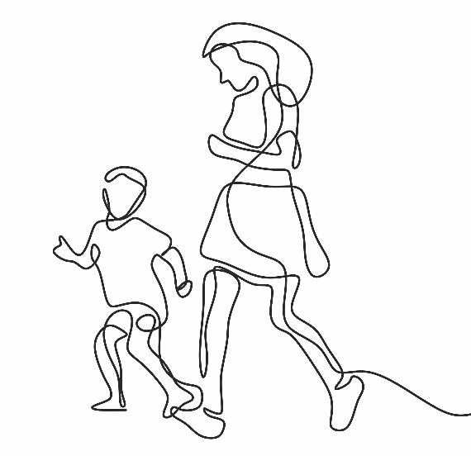
Know Your Audience: Mom
In marketing and promotion, it’s important to know your audience. For Cub Scouts, the target audience is typically a mom.
As you develop your campaign, it’s critical you keep Mom in sharp focus to make sure your message is heard by the right audience at the right time.
To help, we’ve combined dozens of data sources to construct a "Persona," a fictional profile of the person you need to reach.
Get to know Mom in the next slide and always remember to speak to her as you roll out your campaign!

Slide 5
Who is Mom?
WHAT MOM WANTS FOR HER KIDS
Safe. Emotionally healthy. Prepared for real life. Life skills and values. Wants to experience activities with their child. Technology is both a blessing and a curse.
“I am a busy mom who worries about her kids being under pressure and not having time to just be a kid. They are growing up so fast, so I am looking for things we can do together before they no longer want to spend time with me.”
WHERE DOES MOM GO FOR INFORMATION?
Online influencers. Taps internet via mobile device. Online 5+ hrs./day on avg. Reads online reviews before making purchase decision. Friends key info source as well. Prefers to be communicated via email. Trusts communication that comes from her child’s school. Facebook still rules.
BRAND AFFINITIES
A BIT ABOUT MOM...
A bit skeptical. Question marketing and will search the web and social media to validate info.
Spread thin so make things easy. Have less than an hour a day for themselves.
They worry about their kids. Covid has only made it worse.
Doesn’t have a relationship with Scouting in her family.
QUESTIONS MOM HAS ABOUT SCOUTING
Will my children be safe – it’s the first and foremost measure to be addressed. Safety is our number one priority. Scouting has the most comprehensive youth protection policies of any youth organization.
Is Scouting relevant anymore? Is it for families like mine? The ideals the Scouting program teaches are timeless. Scouting builds respect for others, character, fitness and leadership and so much more. Scouting helps youth become their best future selves. It prepares them for life!
Will our kids get exposure to new things and opportunities? Scouting is all about trying new things and new experiences. Whether it’s camping or science – you can find it in Scouting. It’s an amazing adventure for the whole family.
Can girls join? This is still a question! Yes, girls are part of Scouts BSA and Cub Scouts. Scouting is for the whole family!
What will it cost (we don’t want to do fundraising!)? It depends on the unit, but most packs/troops/crews find ways to make the program affordable.
DEMOGRAPHICS OF TODAYS SCOUT MOM
38 | Married | $75K+ HHI | 2 Income | 4 Yr Degree
Mosaic: Council Market Analysis, Kids and Cabernet

Slide 6
Plan for Measurement
How do you know something works? You measure it!
Measurement is an important part of every campaign. It helps you learn what parts of your campaign worked, which need to be improved and when you’ve reached your campaign goals!
Measuring your campaign’s effectiveness depends on the tactics you’re using. For this campaign, here are some easy things to measure.
Social media engagement – Facebook analytics makes it easy to track likes, comments, shares and visits to an event page
Fliers, yard signs or posters - Use QR codes to track click-thru rates.
Emails – Track opens and click-thru rates
Attendance at events - How many people stopped by the event? How many new scouts signed up?
What else can you measure related to your event? And how can you improve? Talk about measurement upfront with your leaders and parents.
Remember: Progress is made where progress is measured!

Slide 7
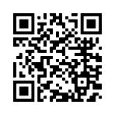
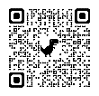
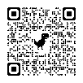
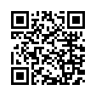
QR Codes Make it Easy!
QR Codes for Online Registration
QR codes make it easy to pull up web sites from your phone. Just point your camera and click!
For Scouting , it QR codes are an incredibly valuable way to connect fliers, posters, yard signs and more to your event.
Remember those busy Mom’s we need to reach? QR codes are also widely adopted by busy families as a fast and efficient way to find info they’re interested in.
Here are some helpful links (and QR codes!) to the BSA’s QR codes for online registration, a Google how-to for creating your own QR codes right from Google’s Chrome browser and a handy QR Code Generator.
On BSA’s Online Registration system, you can find a registration URL and QR code specific to your unit. Include this code wherever you want people to be able to register for your unit immediately online.
Create QR Codes for Everything Else!
Create a QR code for any URL using the QR code Creator in Google’s Chrome browser.
QR Code Generator is also a good place to create your own QR codes at no cost!

Slide 8
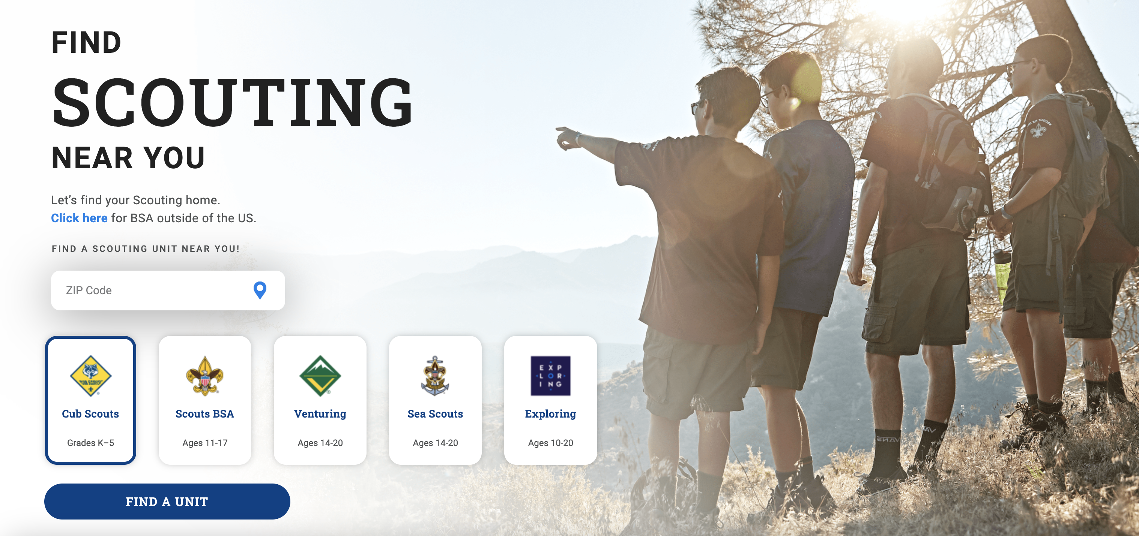
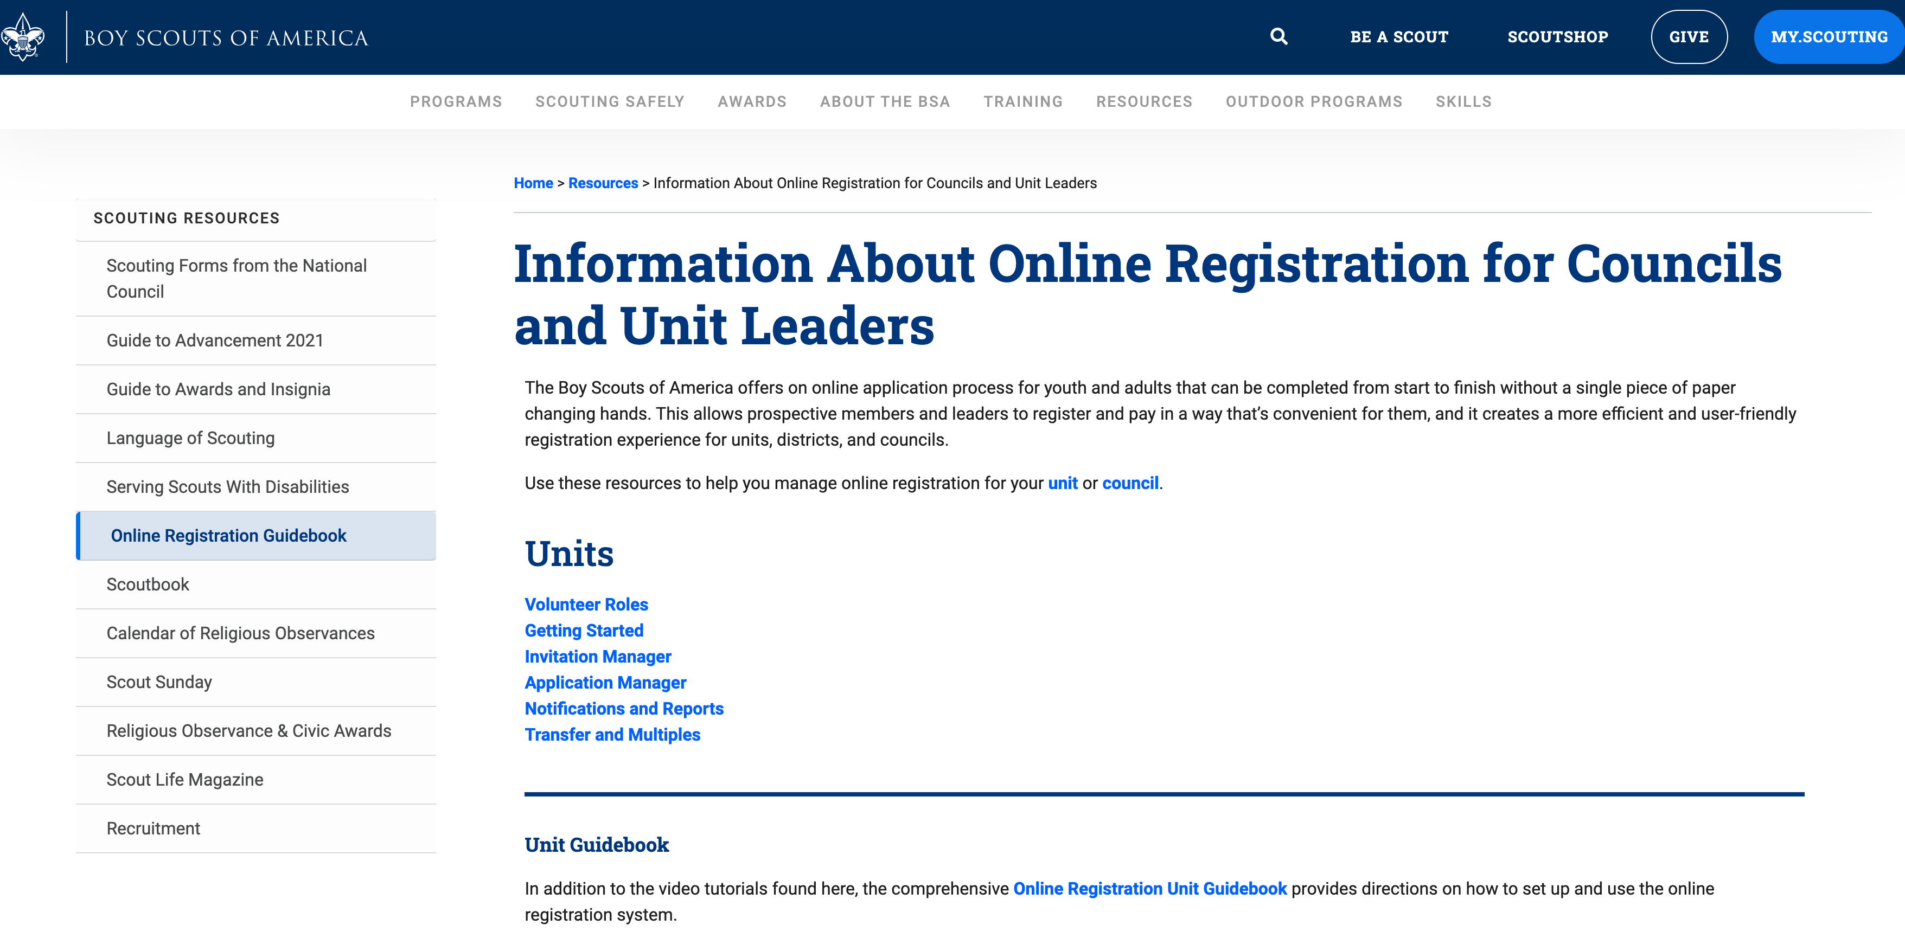
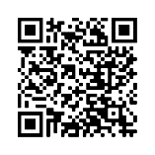
Update BeAScout.org
Sending families to BeAScout.org is the surest way to capture and track those interested in joining.
Before you begin your campaign, it’s important to make sure the information on your BeAScout.org pin is up to date!
Find out how to update your pin here BeAScout.org.

Slide 9
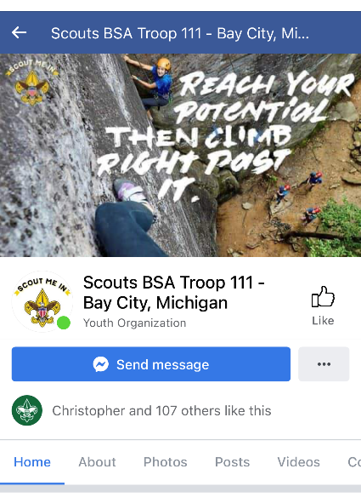
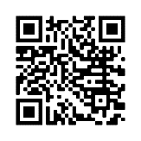
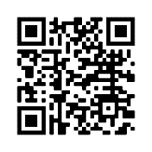
Set Up Your Facebook Page
Make sure you have a Facebook page for your unit. Post photos and video so people can see the fun Scouts have in your unit.
Learn how to set up your own Facebook page.
Or use Facebook’s handy page creator tool.

Slide 10
Build Your Campaign
Let’s get to work setting up the 5 key elements of your promotional plan.
Making the Most of Social Media: Create Your Facebook Calendar Event
Boost Your Facebook Calendar Event
Set up a 6-week social media campaign
Hyperlocal Marketing: Fliers, Yard Signs and Posters – with QR codes!
Spreading the Word: Mobilizing Your Scouting Family

Slide 11
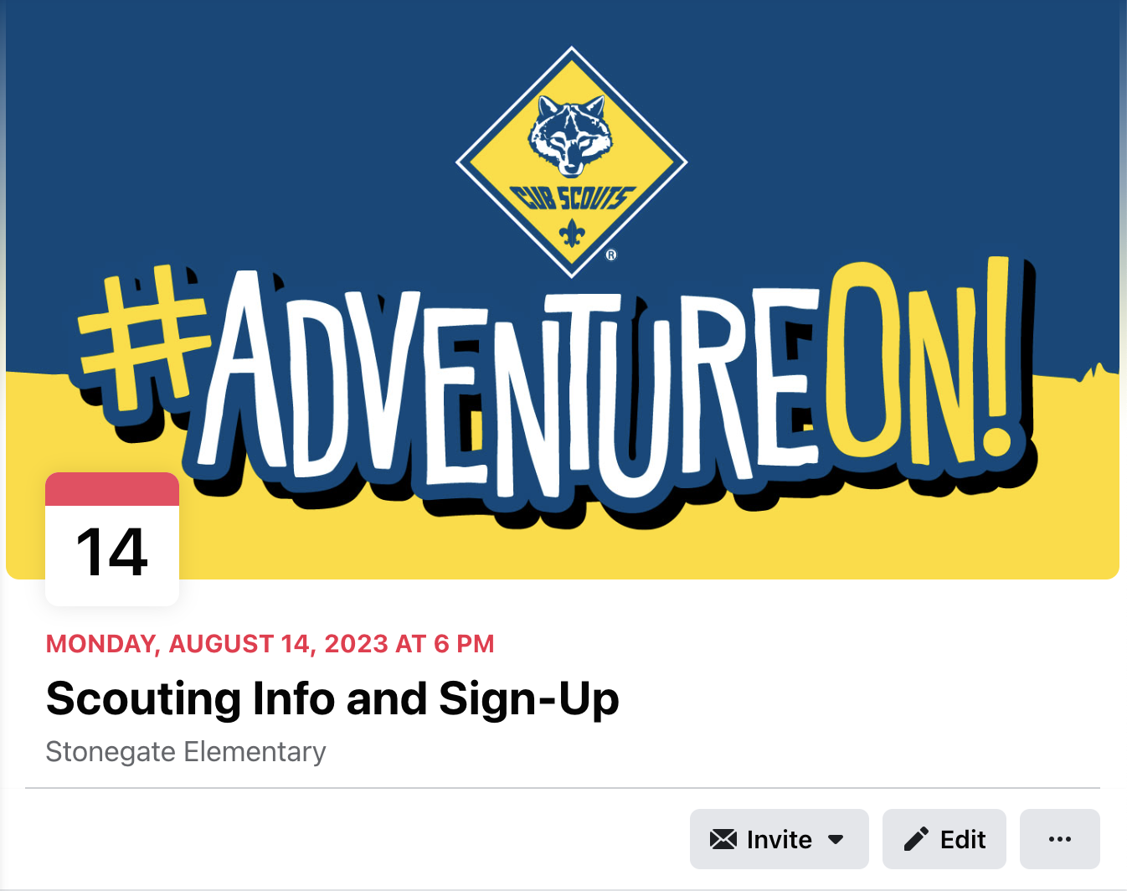
Step 1: Create a Facebook Calendar Event
Every campaign needs a ”landing page” where interested families can be directed to learn more about your event. For Scouting, Facebook Calendar Events are an effective tool for lots of reasons.
A Facebook Calendar Event is a calendar invitation you set up for events like joining nights, meetings and more. Events are easy to create and make it simple to reach people you want to invite to your joining event. Best of all, Moms are familiar with events and very comfortable using them.
Important: To use Facebook calendar events you’ll need an organization page for your Scout unit.

Slide 12
Increase the Impact of Your Facebook Calendar Event
Add a Great Image or Video A picture or video is worth a thousand words, so be sure to add a photo, logo, or video to your invite. Looking for photos? The BSA Brand Center has everything you need.
1
Write a Compelling Description. Tell people why they should attend and any information about your Scouting unit or event.
2
Include your unit’s registration URL. Make it easy for people can register immediately. Find out more about how to find and use your unit’s registration URL.
3
Join Cub Scouts!
Join the Adventure of Cub Scouting at our sign-up event (date, time) at (location).
If your son or daughter enjoys camping, hiking and having fun - then join Cub Scout Pack (unit number)! That’s right – Cub Scouting is for boys and girls. It’s fun for the entire family.
Come by our sign up and join the fun! Can’t come to the sign-up event? Join online at (URL)
Learn How to Create a Facebook Calendar Event

Slide 13
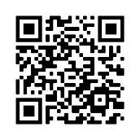
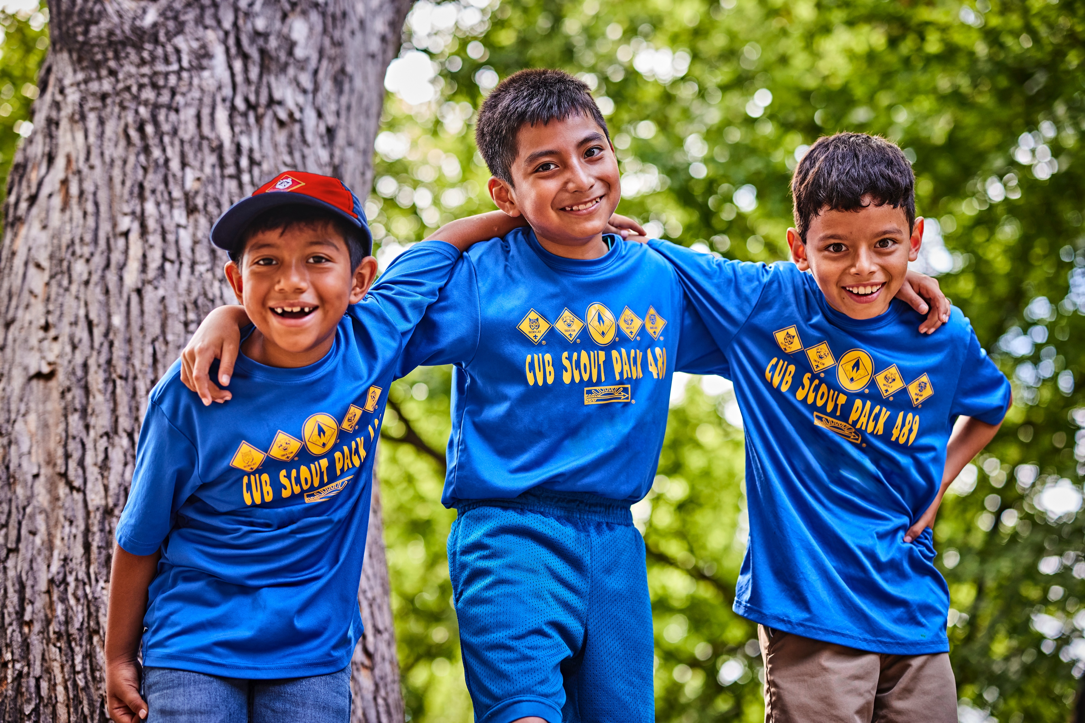
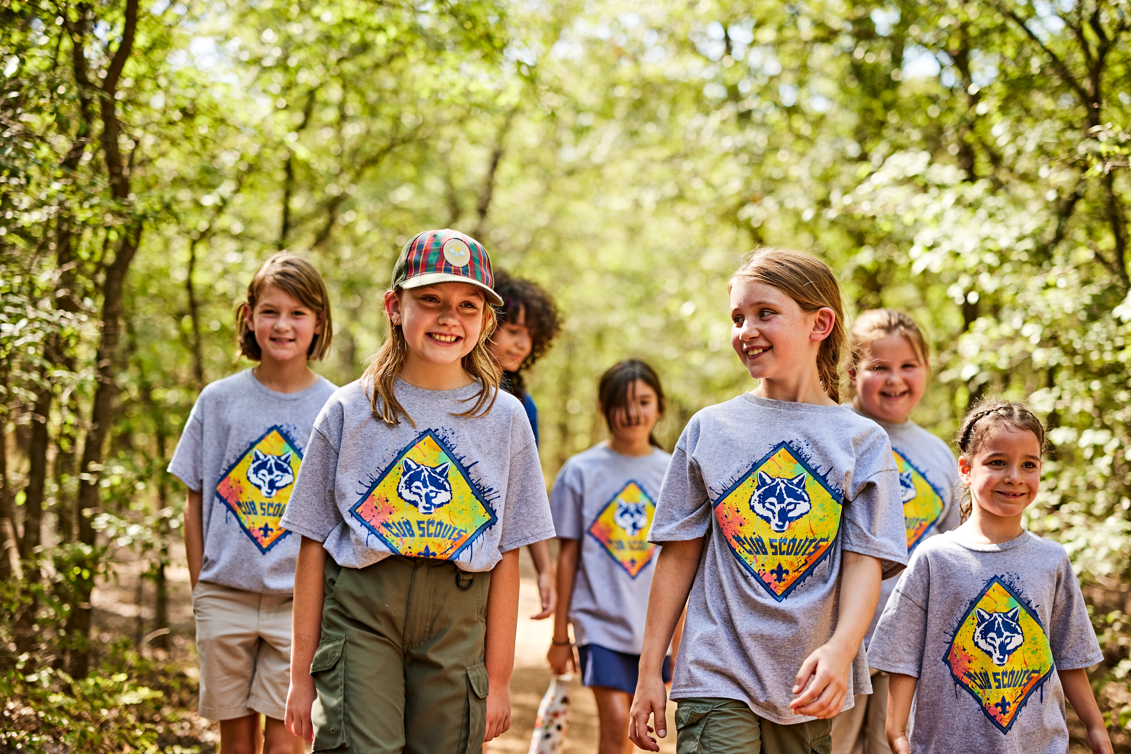
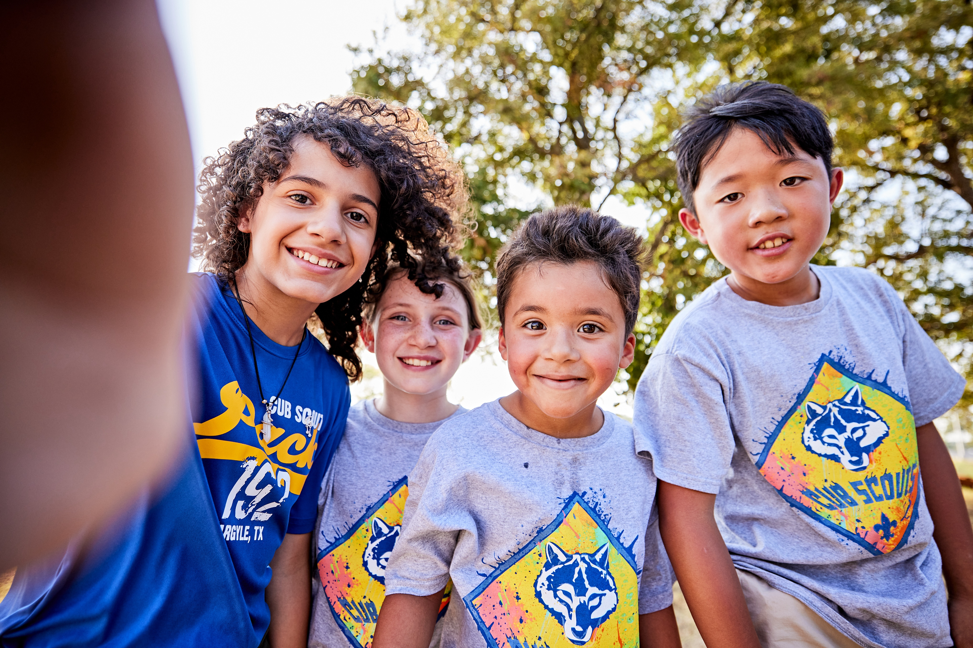
Sample Copy for Your Facebook Calendar Event (Customize these for your pack!)
Join Cub Scouts!
Join the Adventure of Cub Scouting at our sign-up event (date, time) at (location)!
If your son or daughter enjoys camping, hiking and having fun - then join Cub Scout Pack (unit number)! That’s right – Cub Scouting is for boys and girls.
Come by our sign up and join the fun! Can’t come to the sign-up event? Join online at (URL) or Message us or call for more information.
Join Cub Scouts. Join the Adventure!
Time to get outside with Cub Scouts! Cub Scouting is fun in the outdoors with camping, crafts, friends, and much more! And yes - it’s for boys AND girls!
Join at our sign-up event (date, time) at (location). Or join online at (URL).
Message us or call for more information.
Sign Up and Get Outdoors with Cub Scouts! (For Boys AND Girls!)
Cub Scouting is fun with friends in the outdoors! It’s camping, crafts, pinewood derby cars, hands-on learning and so much more!
Drop by our sign-up event (date, time) at (location). Or join online at (URL).
Message us or call for more information.
A Picture is Worth 1,000 Words
Be sure to include a great photo of the Scouts in your unit. Don’t have a photo? Use one from the Brand Center.

Slide 14
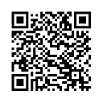
Step 2: Boost the Calendar Event
Once you’ve created your Facebook calendar event, boost the Event so it will be seen by more people.
What is boosting? Boosting is paid advertising and an essential step in promoting your event. For as little as $1 a day, Facebook will promote your event to an audience that is broader than just people who follow or like your page.
This allows you to precisely target who will see your event. For example, you can geotarget parents of elementary school-age youth in a certain geographic such as a zip code or radius around a school or meeting place.
Taking it a step further, you can even geotarget the times and places parents gather - and spend time on their phones! Think Little League games, soccer tournaments or even pick up times at schools.
For tips to selecting the best geotarget settings, review the options on the next slide...
How to Boost a Facebook Event
Here’s how to create an ad to boost your campaign event on Facebook.
Boosting is a powerful, cost-effective marketing tool that’s easy to use!

Slide 15
Choosing the Best Geotargeted Audience
Audience Selections
Geofencing Target: Men & Women age 25-49
Interest Targeting: Parents, Parents of Elementary Age Kids, Parents of 1st Grade, Parents of 2nd Grade, Parents of 3rd Grade, Parents of 4th Grade
Secondary Interest Targeting: Outdoors, Camping, Hiking, STEM
Fence Radius: Generally 2-4 miles around a joining event location . In dense urban areas, you may fence 0.5 miles. In more rural areas you may fence 10 miles. Use the walk/drive distance as a rule of thumb. Fence only as far out as the reasonable person would drive weekly to attend a Den/Pack Meeting.
Do’s & Don’ts
The more targeting info you enter, the narrower your audience will become. Go too narrow and you’ll quickly cut out most of your audience.
You can hold a joining event at one location, but fence around other locations. If you fence around multiple locations, the system will spread your budget across all the locations you fence. In that case, increase the spend so the dollars are not spread too thin to be effective.
Places to consider fencing around?
Anywhere families are visiting. You do not need permission to fence around a location. It is an invisible fence.
Consider schools, family-oriented restaurants, parks, playgrounds, rec centers, grocery stores, stadiums and sports venues, etc. Remember that being local is key. Fence locations that are near the joining event location.

Slide 16
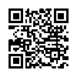
Step 3: Launch Your Own Social Media Campaign
Launch a three-to-six-week social media campaign on Facebook to build awareness of your pack and invite families to join. We’ve made it easy!
How to Schedule a Facebook Post
In the Brand Center you’ll find a sample 6-week schedule of posts to get you started. You can add your own content. The important part is to post regularly to show the fun and adventure youth have in your Cub Scout pack.
Note: Save time by creating your posts in advance in advance, and then use Facebook’s scheduling tool to plan out when they’ll post!
Did you know you can create and schedule your entire set of Facebook posts at once?
Spending some time planning and scheduling posts and they’ll happen automatically!

Slide 17
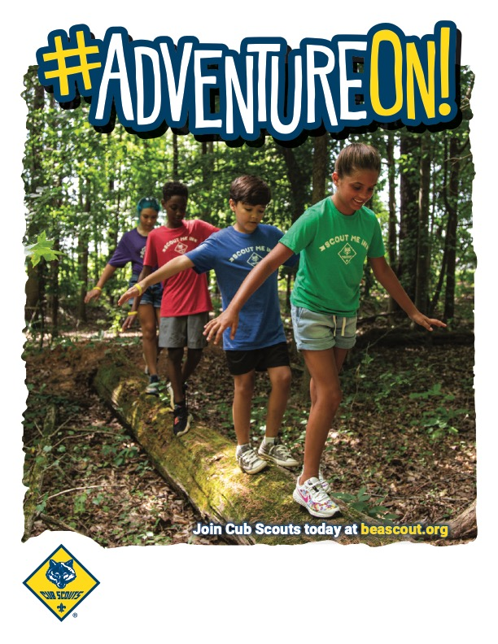
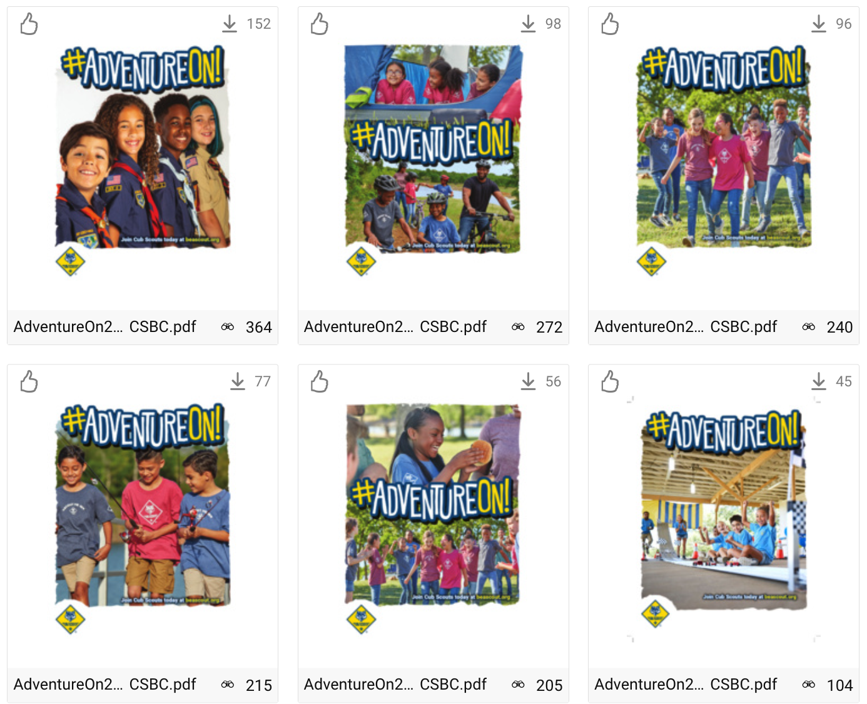
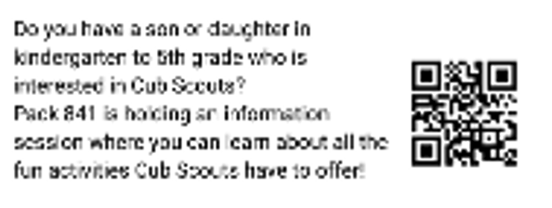
Step 4: Go Hyperlocal with Fliers, Yard Signs and Posters
“All Scouting is Local.”
Because Cub Scout packs are community and neighborhood based, yard signs, fliers and posters are a good way to reach families in your area. Don’t just rely on schools! Distribute join Scouting fliers, posters, and yard signs in and around libraries and friendly businesses.
Ask local business to distribute fliers, for example local pizza restaurants may joining fliers to the top of pizza boxes.
Place yard signs where families go. Fast-food drive-thrus, where school supplies are sold. Don’t forget your own home.
Make sure every flyer, poster or yard sign design includes a QR code to help direct families to your campaign event page. You can even create a unique QR code for each design to measure which type performed the best.
BSA Brand Center…
The BSA Brand Center is the place to find videos, fliers, social media images and plans, posters, peer-to-peer cards and so much more!

Slide 18
Step 5: Mobilize Your Scouting Families
“More hands make light work.”
Reaching families, inviting them to join and onboarding them can be a lot of work if you go it alone. Make sure you ask every leader and parent in your unit to help.
Explain the joining event to your parents and leaders. Break up the tasks and ask people to help.
Ask your families to:
Invite their friends and family to visit meetings – and join
Share posts about the pack and the joining event on their social channels
Distribute posters and fliers to local businesses and organizations
Share news of the joining event to parent teacher association meeting, other and other groups organizations they may be part of.
Drop off fliers to local after-school care centers
Put up fliers and posters on community bulletin boards, coffee shops, grocery stores, etc.

Slide 19
Timelines and Schedules
RECRUITING
Planning is the key to successful marketing efforts (and almost every other effort, too!)
We highly recommend good old-fashioned backdating. For example, if you are planning a joining night, grab a calendar and count backwards from the date of your joining event. Schedule out all your marketing activities!
For example:
Note the event date
Start posting on your Facebook page 3-6 weeks prior to your event
Set up and boost your calendar event 2 weeks prior to your event
Distribute fliers in schools 10 days to 2 weeks prior to your event
Place yard signs at school 1 week prior to your event
… and more…
Don’t skip this step! Map it all out… then meet with other leaders and parents to decide who can help cover all your marketing tactics.
Notes:
Rewrite timetable to show tasks to be accomplished 90, 60, 30 days out etc. Michael has another example of this to share.

Slide 20
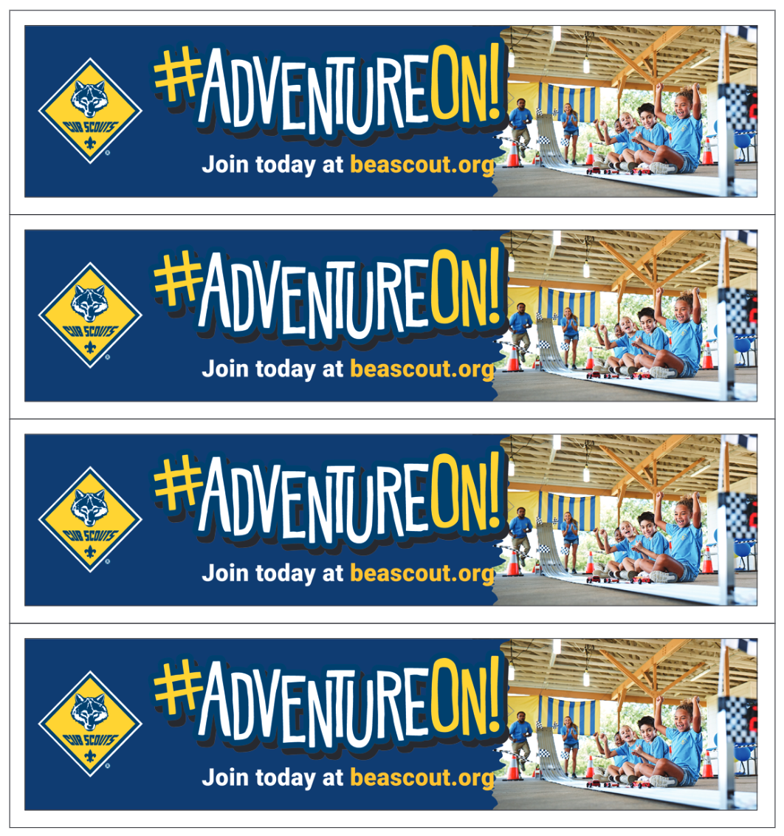
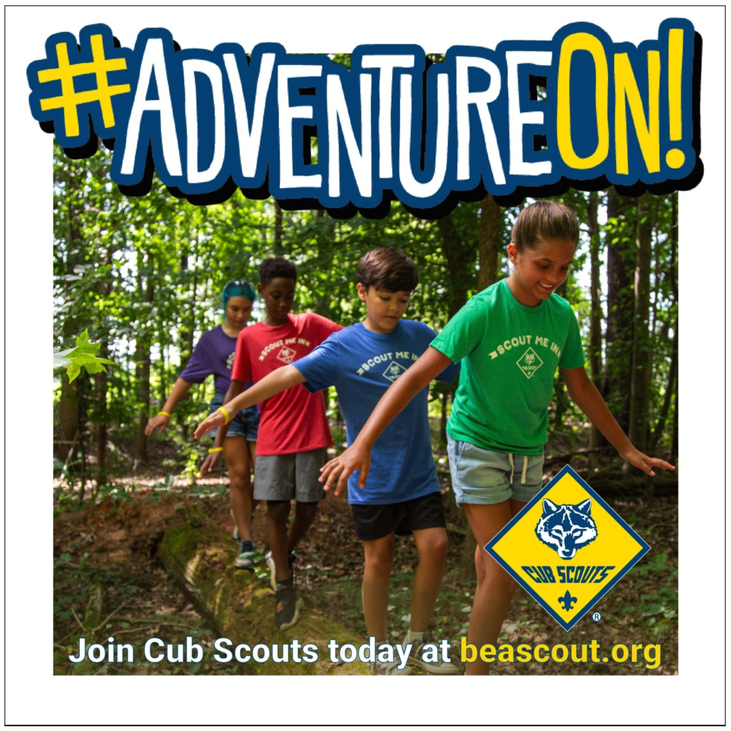
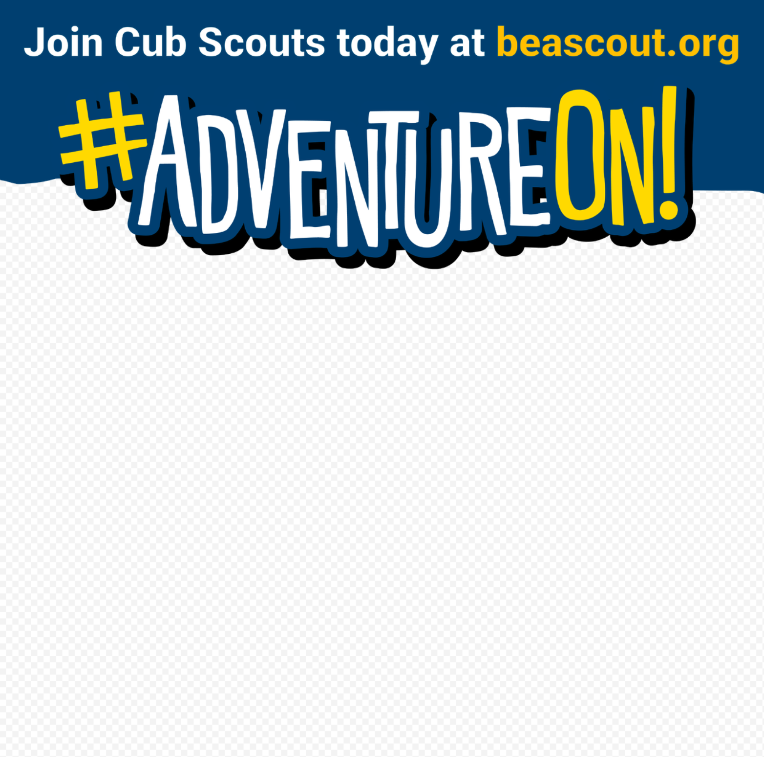
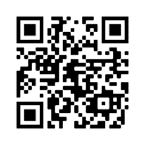
Web Banners
Resources
Find all of your #AdventureOn marketing assets on the BSA Brand Center.
DIY Headers/Footers
Adventure-Themed
Deliver brand promise through outdoor imagery
Dozens of digital and print assets available
Available on the BSA Brand Center
Bookmarks
Social Images
Posters & Fliers
Post Cards
Print Banners

Slide 21
Good luck!

